Slide 1




Titanic Survival Prediction: A Naive Bayes Approach
This presentation explores predicting passenger survival on the Titanic. We use machine learning, specifically Naive Bayes classification. Our process involves data cleaning, feature engineering, and model development.
BY : Group 6
CSE(AI&ML)
Aryan Bhardwaj-53
Arpit Aggarwal-49
Abhay Sharma-06
Ankit Kumar-38
Ayush Saroj-68
Notes:
1

Slide 2
Problem Statement
Historical Context
Dataset Overview
The Titanic's sinking had a profound human impact. Our goal is to predict survival based on passenger features.
We use 891 training and 418 test passengers. The historical survival rate was approximately 32%. Understanding factors influencing survival is key.
Notes:
2

Slide 3

Introduction
1
The Titanic Disaster
2
Naive Bayes Classifier
3
Accuracy Target
The infamous sinking tragically highlighted survival disparities. We aim to predict who survived using machine learning.
Our objective is to achieve over 77% prediction accuracy with our model.
This probabilistic model is suitable for classification. Key features include age, sex, class, fare, and family size.
Notes:
3

Slide 4




Methodology: Data Cleaning & Preprocessing
Handle Missing Values
Median age was used to impute missing 'Age' values. This ensures data completeness.
Convert Categorical Features
'Sex' and 'Embarked' variables were one-hot encoded. This transforms them into numerical format.
Feature Engineering
'FamilySize' was created from 'SibSp' and 'Parch'. This provides a new, insightful feature.
Notes:
4

Slide 5
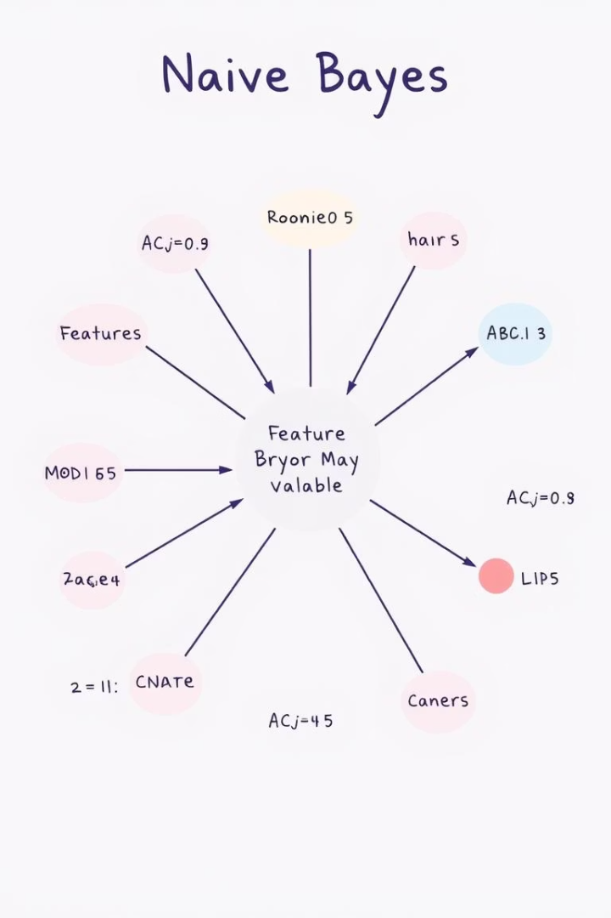
Methodology: Naive Bayes Classification
Algorithm Explanation
Assumptions and Advantages
Naive Bayes is a probabilistic classifier. It assumes feature independence.
It is simple, fast, and performs well. Gaussian Naive Bayes suits continuous features.
Training and Testing
The dataset was split 70% for training, 30% for testing. Laplace smoothing handles zero frequencies.
Notes:
5

Slide 6
Results: Performance Metrics
Accuracy
(TP + TN) / Total
Precision
TP / (TP + FP)
Recall
TP / (TP + FN)
F1-score
2 * (Precision * Recall) / (Precision + Recall)
Our model achieved an accuracy of 77%. This indicates good overall prediction capability. Confusion matrix analysis helps understand classification errors.
Notes:
6

Slide 7
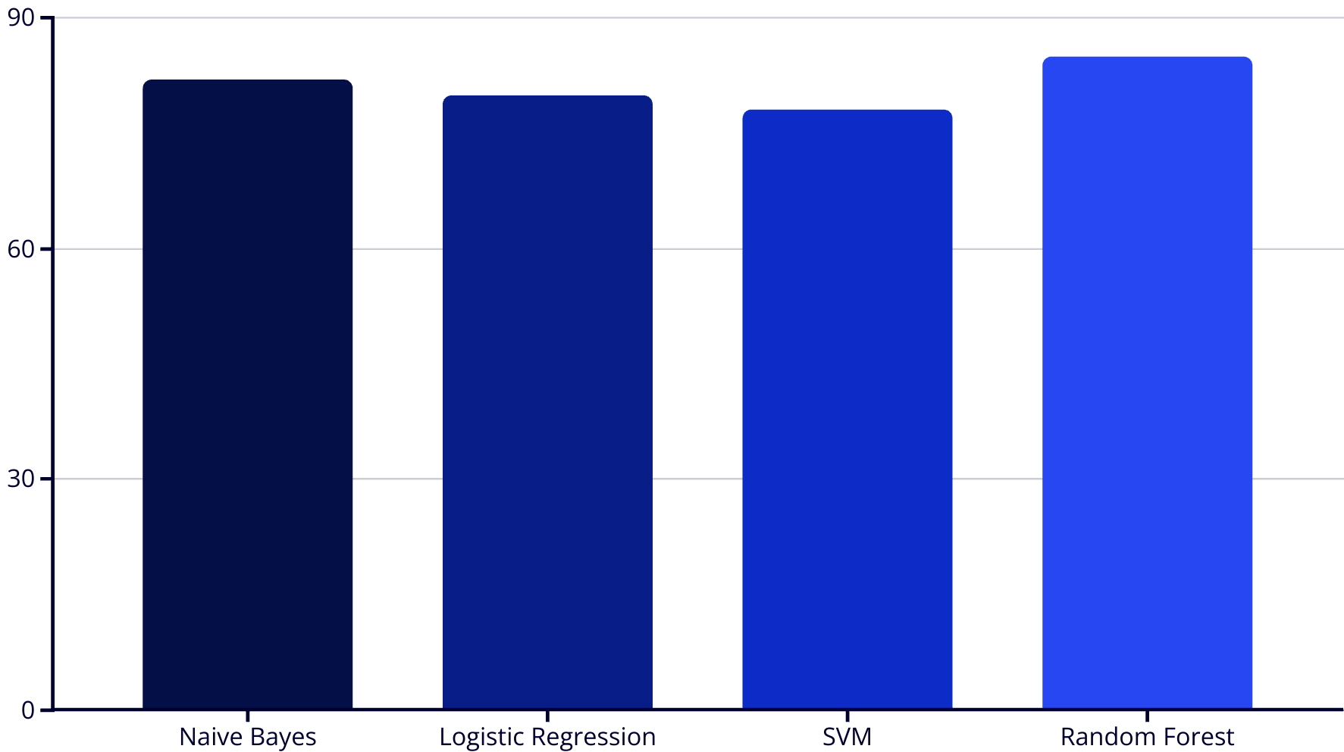
Results: Model Evaluation
The ROC AUC score for our Naive Bayes model was 0.85. This demonstrates strong discriminatory power. Benchmarking against other models, Naive Bayes performs competitively.
Notes:
7

Slide 8

Conclusion
1st
Female
Class
Sex
Upper class passengers had higher survival rates. Economic status played a significant role.
Female passengers were more likely to survive. "Women and children first" policy.
Small
Family Size
Smaller family groups had better odds. Easier evacuation for fewer people.
Our model highlights key factors influencing survival. Class and sex were major determinants. Further improvements could enhance prediction accuracy.
Notes:
8

Slide 9






Future Work
Cross-Validation
Implementing k-fold techniques for robust evaluation.
Hyperparameter Tuning
Using GridSearchCV for optimal model parameters.
Ensemble Methods
Exploring Random Forest or XGBoost for better predictions.
These next steps will refine our model. They aim to improve its generalization and performance. Continuous improvement is crucial for predictive accuracy.
Notes:
9

Slide 10

References
Kaggle. Titanic - Machine Learning from Disaster dataset. Link to dataset
Russell, S. J., & Norvig, P. (2010). Artificial Intelligence: A Modern Approach. Prentice Hall.
Naive Bayes Classifier. Wikipedia
Images source:-www.Google.com
This project leveraged publicly available data and established machine learning principles. For further exploration, consult these resources.
Notes:
10

